Slide 1
INTERDISCIPLINARY COLLABORATIVE CORE (ICC) CC0005 HEALTHY LIVING AND WELLBEING TUTORIAL 2 HEALTH AND NUTRITION
Ms Janice Tay

Slide 2
COPYRIGHT STATEMENT
All course materials, including but not limited to, lecture slides, handout and recordings, are for your own educational purposes only. All the contents of the materials are protected by copyright, trademark or other forms of proprietary rights.
All rights, title and interest in the materials are owned by, licensed to or controlled by the University, unless otherwise expressly stated. The materials shall not be uploaded, reproduced, distributed, republished or transmitted in any form or by any means, in whole or in part, without written approval from the University.
You are also not allowed to take any photograph, film, audio record or other means of capturing images or voice of any contents during lecture(s) and/or tutorial(s) and reproduce, distribute and/or transmit any form or by any means, in whole or in part, without the written permission from the University.
Appropriate action(s) will be taken against you including but not limited to disciplinary proceeding and/or legal action if you are found to have committed any of the above or infringed the University’s copyright.

Slide 3
By the end of today’s lesson, you should be able to:
Determine Basal Metabolic Rate for Daily Energy Expenditure.
Evaluate personal food intake from macronutrients and micronutrients
Critically analyse food labels for nutritional information and food claims

Slide 4
BMR
IS THE MINIMUM YOU NEED IN A DAY TO FUNCTION AS A HUMAN BEING
RECAP
Notes:
Understanding your BMR, your typical activity level, and the amount of calories you need daily to maintain your weight are important ways for you to actively participate in your physical health.
Whether you need to gain weight, maintain your current weight, or lose weight, calculating your BMR is a good place to start.

Slide 5
RMR vs BMR
RESTING METABOLIC RATE
BASAL METABOLIC RATE
Usually measured 3-4 hours after a light meal without prior physical activity
Measured in total fasting and restful state
Notes:
Basal metabolic rate (BMR) is often used interchangeably with resting metabolic rate (RMR). While BMR is a minimum number of calories required for basic functions at rest, RMR — also called resting energy expenditure (REE) — is the number of calories that your body burns while it's at rest.

Slide 6
Factors affecting a person’s BMR?
GENDER
ACTIVITY LEVEL
AGE
HEIGHT/WEIGHT
BODY COMPOSITION
ILLNESS
GENETICS
TEMPERATURE
Notes:
Body Composition The amount of muscle tissue on your body. Muscle requires more energy to function than fat. So the more muscle tissue you carry, the more energy your body needs just to exist. (Resistance or strength training is most effective for building and maintaining mass.)
Age As you get older, your metabolic rate generally slows. This is because of a loss of muscle tissue and changes to hormonal and neurological processes. During development children go through periods of growth with extreme rates of metabolism.
Height/Weight Those with bigger bodies have a larger BMR because they have larger organs and fluid volume to maintain.
Gender Men generally have faster metabolisms than women.
Genetics Some families have faster BMR than others with some genetic disorders also affecting metabolism.
Activity Level Exercise increases muscle mass and powers up your metabolic engines burning kilojoules at a faster rate, even when at rest.
Illness Hormonal imbalances such as hypo & hyperthyroidism can affect your metabolism.
Temperature Increased heat or cold forces the body to work harder to maintain its normal temperature and increases BMR.

Slide 7
Harris-Benedict equation
... is a formula that uses your BMR to determine your total daily energy expenditure (calories)
Notes:
The Harris Benedict equation is a calorie formula using the variables of height, weight, age, and gender to calculate basal metabolic rate (BMR). This is more accurate than calculating calorie needs based on total body weight alone.

Slide 8
FORMULA FOR CALCULATING BMR
ACTIVITY #1
FOR MALES
BMR = 88.362 + (13.397 × weight in kg) + (4.799 × height in cm) - (5.677 × age in years)
FOR FEMALES
BMR = 447.593 + (9.247 × weight in kg) + (3.098 × height in cm) - (4.330 × age in years)
Time allotted : 10 Minutes
Notes:
Students to calculate their BMR based on the formula given
The total number of calories burned for energy each day is the total daily energy expenditure
Using the BMR to derive our daily energy expenditure can help to estimate our daily caloric needs
Our daily caloric needs is derived from the food we eat

Slide 9
ACTIVITY #1
Go to MyFitnessPal https://www.myfitnesspal.com/food/search
2. Analyse the macronutrients and micronutrients of 2 different types of food
3. Brainstorm healthy meal ideas
Note: Except For Vitamin D, K and Niacin, All Other Micronutrients Must Be Derived From Food
Time allotted : 35 Minutes

Slide 10
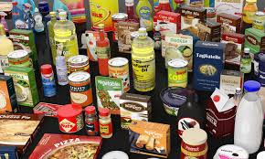
F O O D
The energy content of food is expressed in calories (kcal) or kilojoules (kj)
A calorie is a unit that is used to measure energy
One kcal equals 4.184 kj

Slide 11
The Atwater system has been widely used, in part because of its obvious simplicity
1 g of carbohydrates = 4 kcal
1 g of fat = 9 kcal
1 g of protein = 4 kcal
1 g of alcohol = 7 kcal

Slide 12
(a) Macronutrient Energy Content and Percentage Composition of Sweet Home Granola
Activity #2
FOOD ITEM | TOTAL CALORIES (kcal) | FAT (g) | CHO (g) | PROTEIN (g)
(a)Sweet Home Granola (per serving) | 240 | 9 | 36 | 5
Nutrient | Weight (g) | Atwater GF | Kcal | % of Total Kcal
Fat | 9 | 9 | 81 | 33.8
CHO | 36 | 4 | 144 | 60
Protein | 5 | 4 | 20 | 8.3

Slide 13
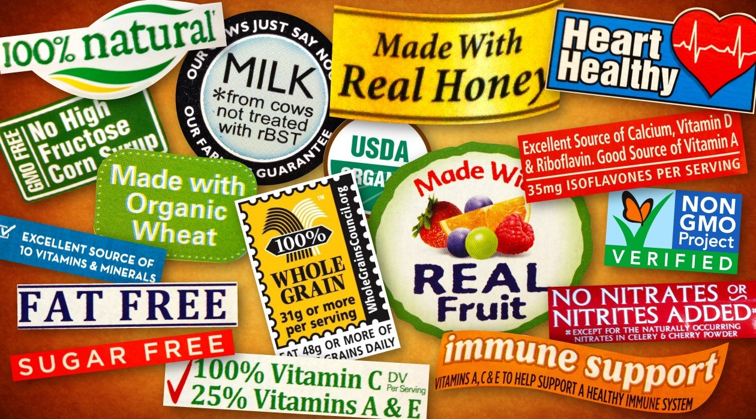
In Singapore, most food products in the market are labelled with Nutrition Information Panel (NIP), although this information is only compulsory when a nutrient or health claim on food is made.

Slide 14
FOOD LABEL CLAIMS
Calorie Free
Less than 5 calories
Low Calorie
40 calories or less
Light or Lite
⅓ fewer calories or 50% less fat
Fat Free
Less than ½ gram fat
Low Fat
3 grams or less fat
Notes:
These are some examples of food label claims

Slide 15

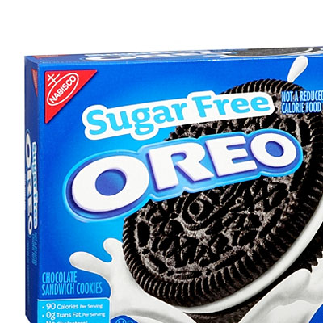
Sugar Free
Less than 0.5 grams sugars and no ingredient that is a sugar
Reduced Sugar Or Less Sugar
At least 25% less sugars than the regular product
No Added Sugar
No sugar or sugar-containing ingredient added during processing or packaging
Notes:
More examples of food label claims

Slide 16
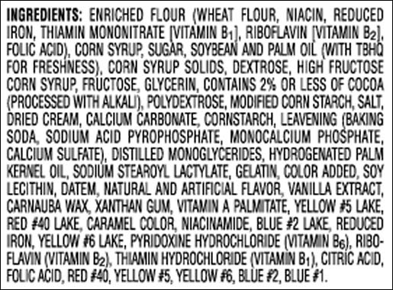
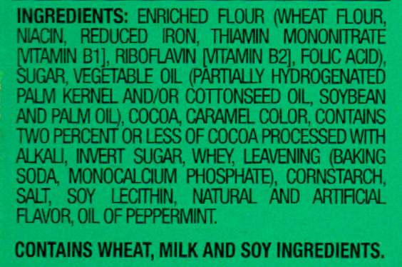
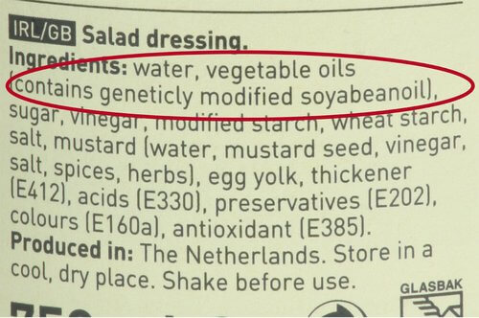
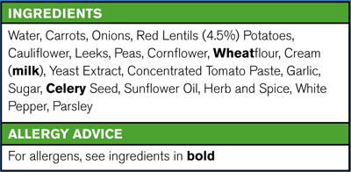
INGREDIENTS LIST
Notes:
*Slide includes 4 ingredient list overlapping each other (go to slide show mode to see slides
Highlight the need to scrutinise ingredient lists
Ingredient list further substantiate any nutrient claims
The first slide shows ingredients that are recognisable food names
The second slide shows ingredients that contains additives such as Thiamine Mononitrate and chemical compound such as Monocalcium Phosphate
The third slide shows ingredients that are genetical modified and contains different additives under the E numbers
The last slide shows ingredients that sounds more chemical-like than food
Ingredients listed first has the highest proportion and it goes in descending order
Ingredient lists with numbers means it has more additives in them
Ingredient lists with chemical names means it contains these chemicals in its processing

Slide 17
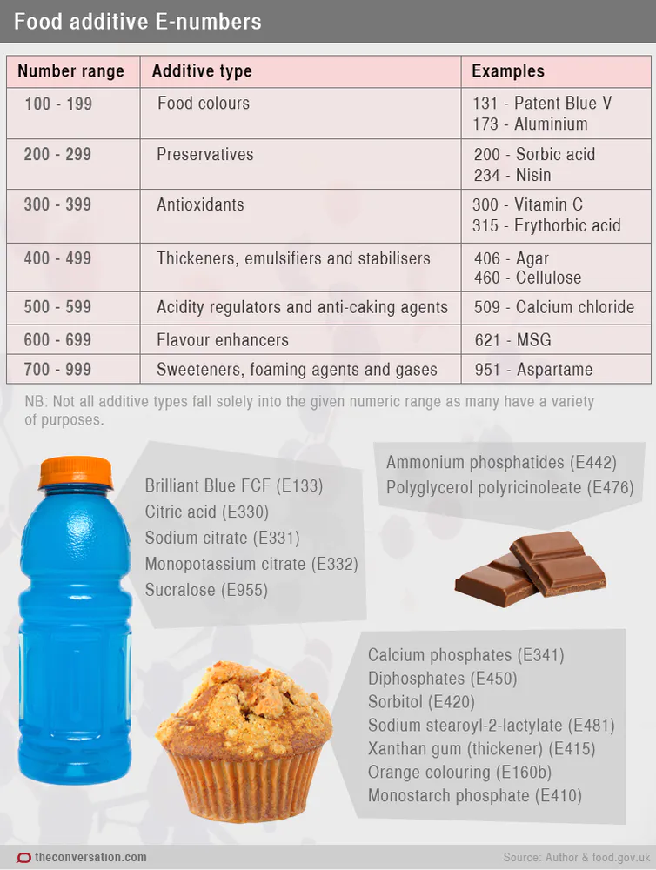
E numbers
Notes:
Optional slide, E numbers are simply a numbering system that is used internationally to describe different types of food additives.

Slide 18
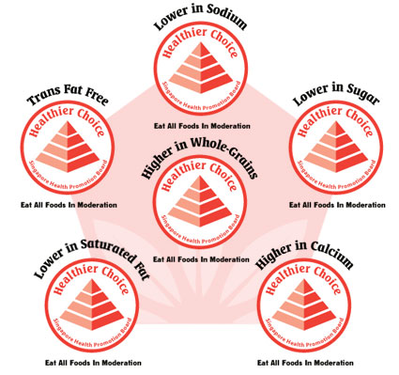
HEALTHIER CHOICE SYMBOL
BY SINGAPORE HEALTH PROMOTION BOARD
Notes:
Optional Slide Consumers can look out for these symbols when purchasing food
The Healthier Choice Symbol (HCS) is awarded to food products which meet HPB's HCS nutritional criteria
Products carrying this symbol contain at least 20% more wholegrains compared to similar products from the same food category
Though these HCS labelled foods are healthier than those in similar food groups, all foods that are consumed in excessive amount can cause weight gain

Slide 19
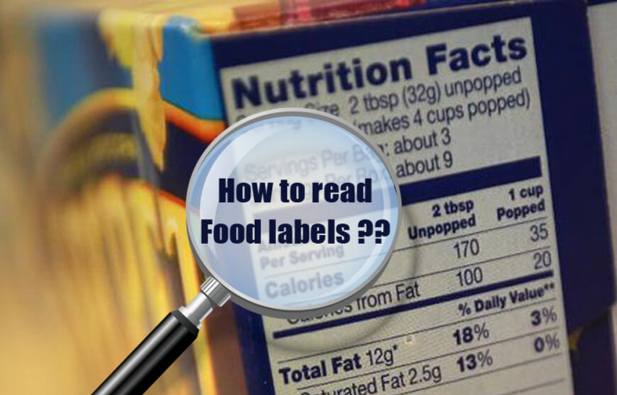

Slide 20
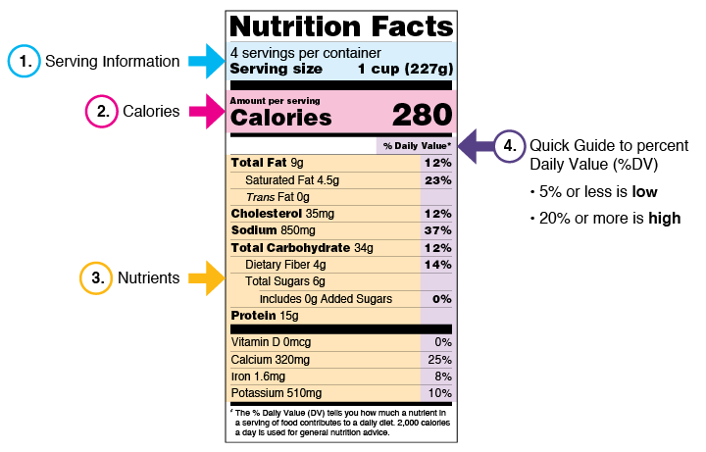
READING FOOD LABELS
Notes:
Reading food labels is a useful skill to have
We live in a world full of processed food
Learning how to decipher what is in your food will help you make wise food choices
#1 Serving Information
Pay attention to the serving size, especially how many servings there are in the food package
It is not a recommendation of how much you should eat or drink
#2 Calories
Calories provide a measure of how much energy you get from a serving of this food
The number of servings you consume determines the number of calories you actually eat
#3 Nutrients
It shows you some key nutrients that impact your health.
Nutrients to get more of:
Dietary Fiber, Vitamin D, Calcium, Iron, and Potassium.
Nutrients to get less of:
Saturated Fat, Sodium, and Added Sugars
#4 Percent DV
It shows how much a nutrient in a serving of a food contributes to a total daily diet
General Guide to %DV
5% DV or less of a nutrient per serving is considered low
20% DV or more of a nutrient per serving is considered high
Percent DV is based on a 2000 calories diet of an adult

Slide 21
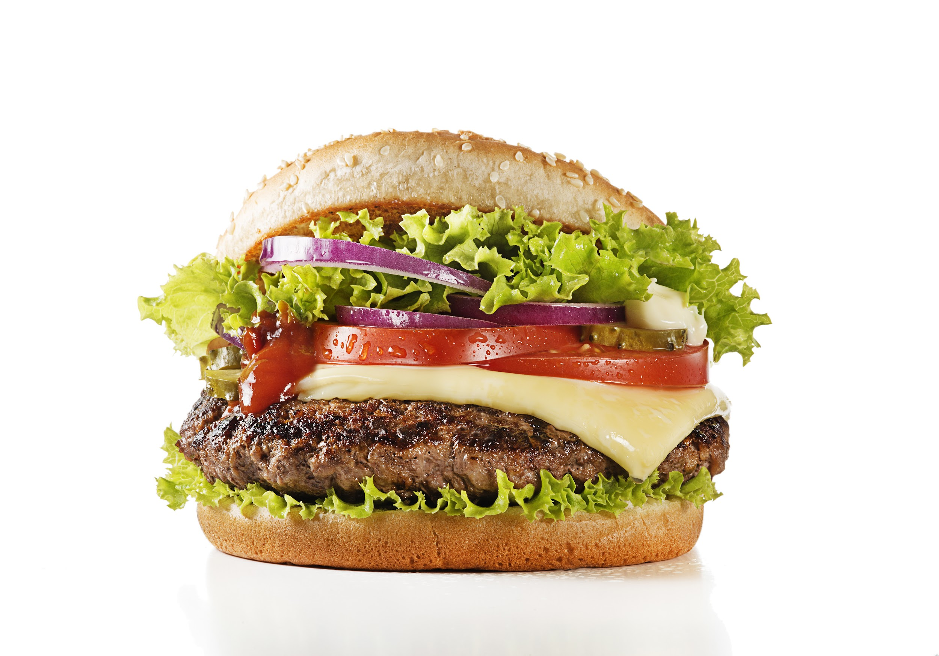
DO YOU SEE A HAMBURGER?

Slide 22
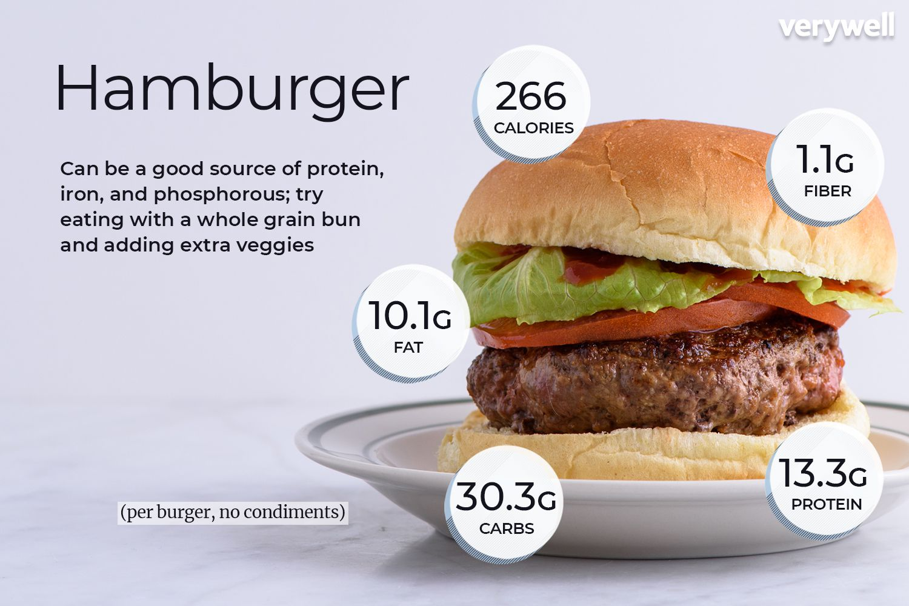
OR… Do you see a...

Slide 23
Key Takeaways for today’s lesson:
We learnt that daily calorie intake, whether in excess or deficit, has its implications.
Food loaded with the right nutrients is key to healthy living.

